Slide 1
Software requirements specification (SRS)

Slide 2
SRS (Software Requirements Specification)
What is SRS ?
SRS Organization/ Structure
Uses of SRS (stakeholders perspective)
Benefits of SRS
Validation/Checking of an SRS document
Characteristics of a Good SRS

Slide 3
SRS (Software Requirements Specification)
An SRS document is generated as the output of Requirements Analysis.
An SRS is a description of a software system to be developed.
** Functional and Non-functional Requirements

Slide 4
Functional and Non-Functional Requirements
Functional Requirements (mentioned expectations):
Software requirements specification (from clients side requirements too)
Technical details, Data/Reports processing expectations etc.
Non-Functional Requirements (non-mentioned expectations):
Operational Requirements (portability, maintainability)
Performance Requirements (speed, capacity)
Security Requirements (digital certificate, access control, reliability)
Cultural and Political Requirements (social, language, legal, unstated norms etc.)

Slide 5
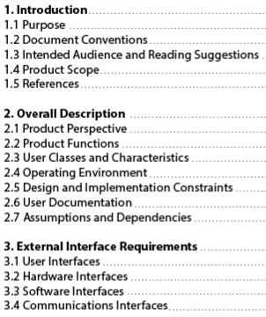
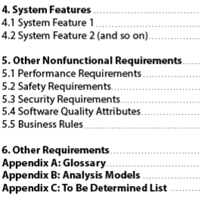
SRS (Software Requirements Specification): Table of Contents

Slide 6
Uses/Purposes of SRS (stakeholders perspective)
Project managers base their plans and estimates of schedule, effort, and resources on it.
Development team needs it to develop the product.
Testing group needs it to generate test plans
Publications group writes documents, manuals, etc.
Customers rely on it to know what product they can expect.
Training personnel can use it to help develop educational material
Maintenance and Support staff need it to understand what the software product is supposed to do.

Slide 7
Validation of an SRS document
It is extremely important to detect errors in the SRS document before going to other phases.
The major objective of SRS validation is to ensure: Completeness and Correctness
In Validation checking phase we have to avoid the following Errors:
1. Omission: Some user requirement is not included in the SRS. This error directly affects the external completeness of the system.
2. Inconsistency: Due to contradictions in requirements or incompatibility of state requirements.
3. Incorrect fact: Some facts recorded in the SRS are not correct.
4. Ambiguity: Some requirements have multiple meanings.

Slide 8
Characteristics of a Good SRS
1. Correctness
2. Completeness:
(i) The involvement of all Concerned Stake holders
(ii) Focusing on all Problems, Goals, and Objectives, and not only on functions and features.
(iii) Correct definition of scope and boundaries
3. Unambiguous: An SRS is unambiguous if and only if every requirement stated has one and only one interpretation.
4. Verifiable: An SRS is verifiable if and only if there exists some cost-effective process that can check whether the final product meets the requirements.
5. Modifiable: An SRS is modifiable if its structure and style are such that any necessary change can be made easily while preserving completeness and consistency.
6. Traceable: The SRS is traceable if the origin of each of the requirements is clear and if it facilitates the referencing of each requirement in future development or enhancement documentation.

Slide 9
Characteristics of a Good SRS
7. Consistency: Consistency is essential to achieve correct results across the system by:
(i) The use of standard terms and definitions.
(ii) The consistent application of business rules in all functionality etc.
8. Testability: An SRS should be written in such a way that it is possible to create a Test plan to confirm whether specifications can be met and requirements can be delivered considering: Functional and non-functional requirements
9. Clarity: An SRS is clear when it has a single interpretation for the author. This is possible if the language of the SRS is unambiguous.
10. Feasibility: SRS needs to be confirmed on technical and operational feasibility.

